Slide 1
Data Loss Protection Blueprint
Subtitle goes here
—
Date

Slide 2
Agenda
 | Page
1. Discovery | 4
2. Lifecycle and Data Flow | 6
3. Framework | 9
4. Use Cases | 11
5. Classification and Labelling | 13

Slide 3
Introduction
This deck will detail the steps to be taken when looking into data loss protection (DLP) for a client organisation. Depending on the scope of work you may be asked to design a DLP lifecycle, rules, policies and use cases for the client.
This document is not intended to cover all eventualities but to act as a rough guid when approaching a DLP focussed workstream or engagement.

Slide 4
1. Discovery

Slide 5
Discovery
Begin by meeting with stakeholders and gaining an overview of the state of DLP within the client organisation. The below questions and documentation requests should be key points to focus on in these meetings. This list Is not exhaustive and you will need to ask additional tailored questions as you discover more about the organisation.
Workshop questions for stakeholders
What are the current critical data sources, key threat vectors and current lifecycle process and sensitive information categories?
What are the critical applications that are used for sharing/storing data?
What are the type of DLP Policies/rules deployed and what business processes are they used in?
Has any risky behaviour been identified that should be limited?
Is there any benchmark which are adhered e.g. NIST.
What are the current DLP policies and what is the incident management life cycle?
What are the current processes in place regarding DLP (for incident notification, policy creation, reviewing of incidents).
What sort of data classification and labelling do you have in place?
Documentation requests
Lists of actively used DLP policies/rules for applications, firewalls, SIEM and other relevant software/systems.
Documented business policies, processes, lifecycle and diagrams on the subject of DLP or referencing DLP.
Please Note: Document classification is not to be removed.

Slide 6
2. Lifecycle and Data Flow

Slide 7
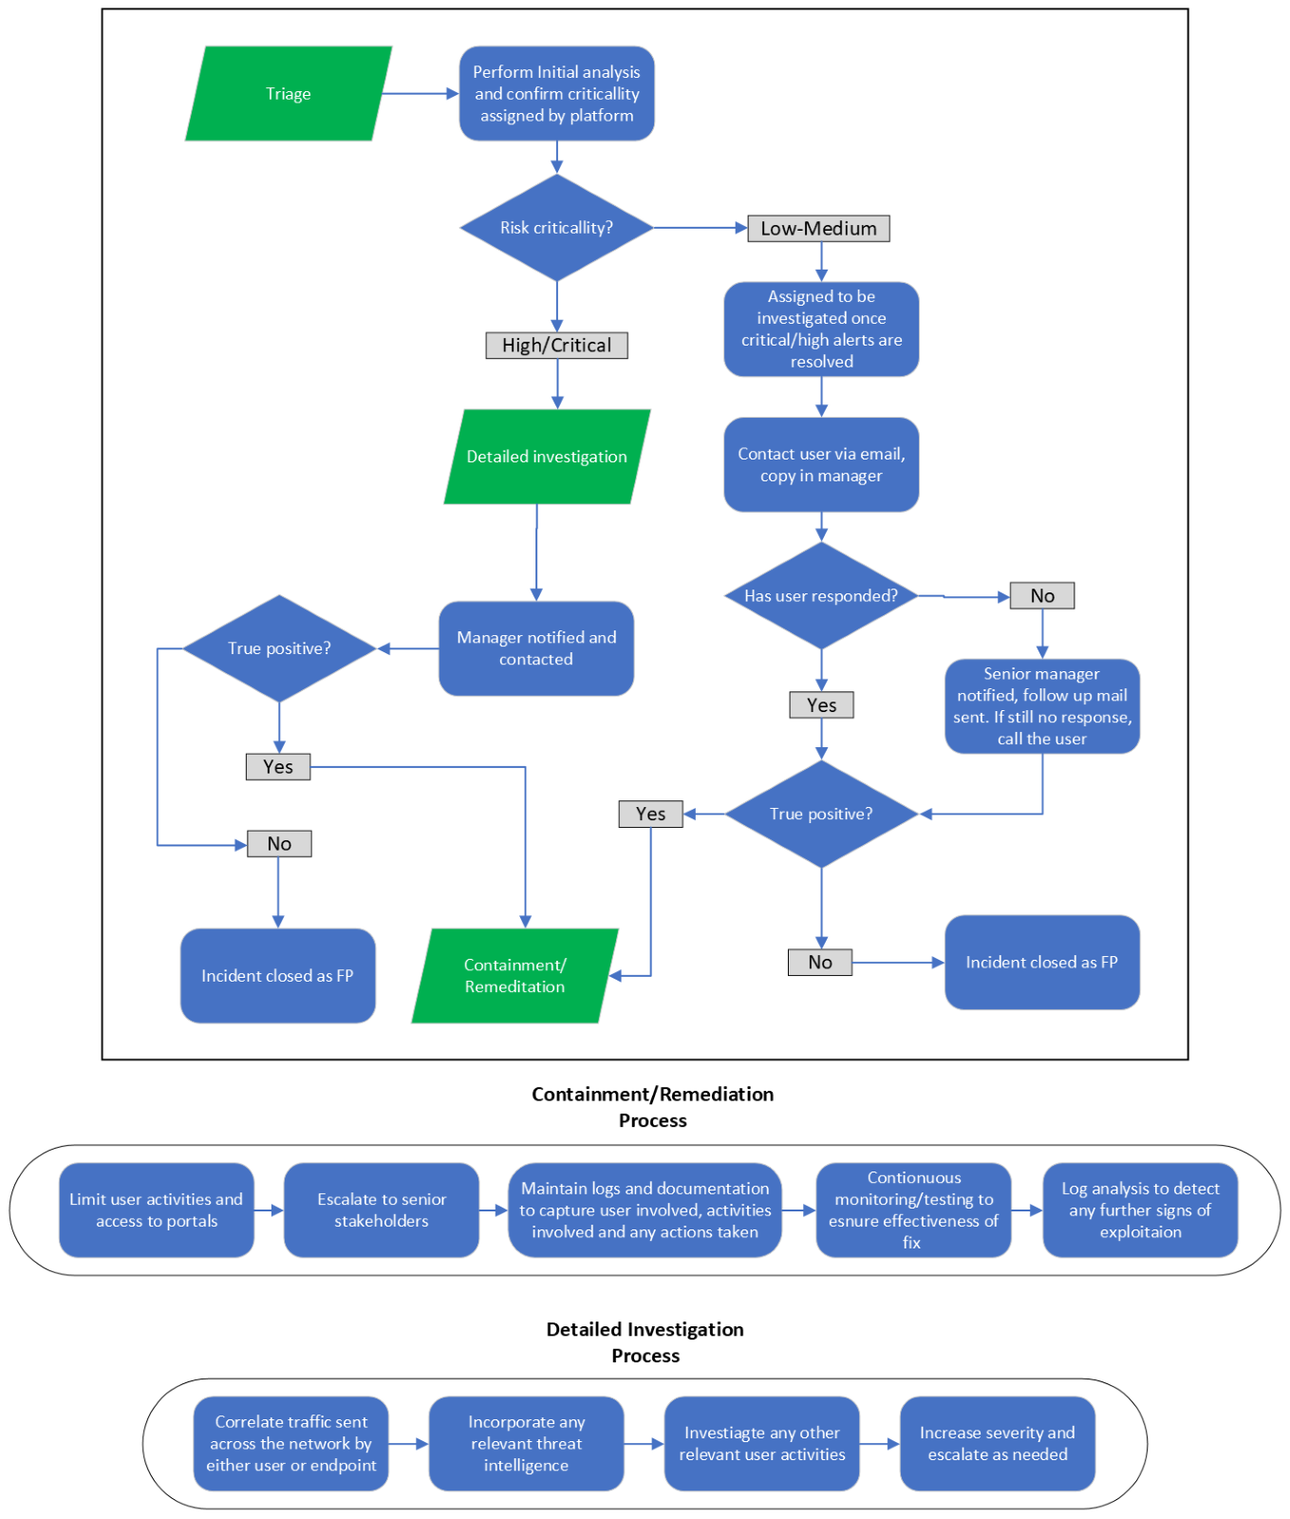
Deliverable: Lifecycle
Following the discovery stage you should map out the clients current DLP lifecycle. This is the process of alerting when a DLP policy or rule is breached/triggered, to triage, investigation, response, and post event analysis.
The client may already have a lifecycle documented.
The second task in this stage is then map a target DLP lifecycle based on the clients needs and the agreed scope of work.
The end goal is to produce a lifecycle process document, including flowcharts, to be used and referenced to by the client organisation’s employees.
See an example DLP lifecycle flowchart to the left.
The final deliverable will be a target lifecycle document for the client to work toward.
Please Note: Document classification is not to be removed.

Slide 8
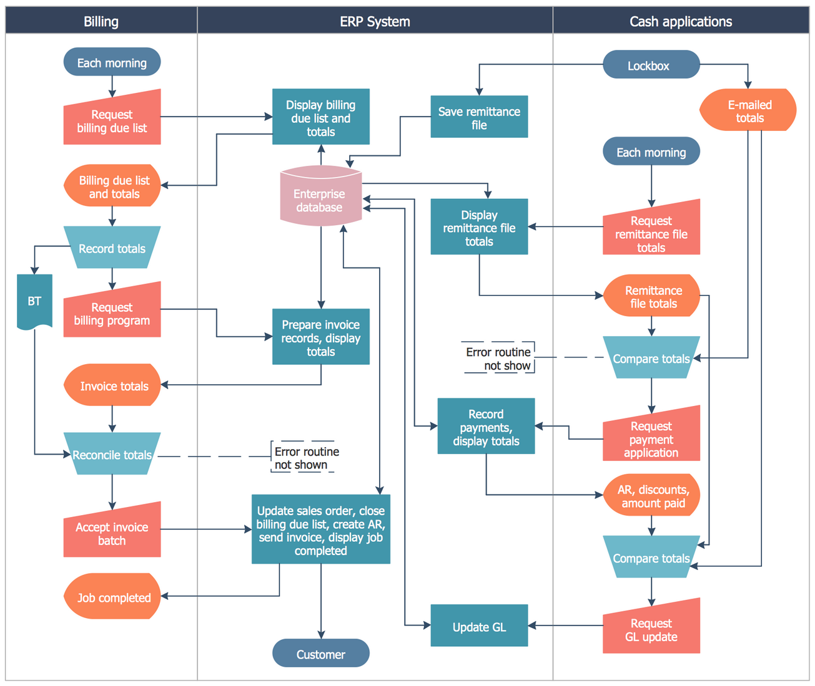
Data Flow
Mapping data flow within the client organisation is important as it helps you gain an understanding of the way data moves across applications for the various business processes. Mapping all data flow within an organisation will be a huge task, so it is better to focus on the business critical processes, and those where the most critical data is used.
Once this exercise is completed, you may notice points in the flow where data is less secure or at risk.
Please see an example data flow diagram to the right.
Please Note: Document classification is not to be removed.

Slide 9
3. Framework

Slide 10





Proposed methodology for the DLP use cases
The below methodology can be used when mapping current use cases and designing new ones.
Identification process
Data Theft Technique
Nature of Data
Attack Vector
Volumetry threshold
Logic query
Where has the data originated?
What kind of data is sent?
How can a malicious actor attack us?
How many events should trigger an alarm?
How can I describe the scenario?
Key points:
Identify where the exfiltration takes place
Which tools are used for the exfiltration?
Is any security policy in place?
The technology has auditing capabilities?
Key points:
Financial data related to clients. (Client Name, Client ID, Cost)
Legal contracts with the client
Price sensitive information
Case Reports
Case studies
Key points:
Identify the main channels for the exfiltration
Known exfiltration techniques
Key points:
One time exfiltration vs recurrent
Maximum volume of data exfiltration per communication
Some files could require several other parts to exfiltrate information
Key points:
Source or actor
Destination or receiver
Action made
Condition
Temporal clauses
Exclusion clauses
Examples:
T1048: Exfiltration over alternative protocols
T1114.001: Local Email collection
T1190: - Exploit Public-Facing Application
Examples:
Internal IT data
Personal data
Documents containing passwords or other credentials
Examples:
Email
Internet
USB
Paper
Examples:
1 Email
1 File copied to an USB
100 MiB of transferred data
Examples:
Action: send an email
Condition: File contains password information
Exclusion: not applicable for IT staff

Slide 11
Information Types
Source | Sensitive info type | Filetype | Category of files
Purview | Financial data: bank account numbers | .pdf , message body, .dox, .xlsx | Invoices, employment advice,
 | Passport numbers | .pdf, . xlsx, .doc, message body, .docx, | ID, project drafts, applications, agreements,
 | National ID numbers | .pdf, . xlsx, .doc, .docx, | ID, tax information, applications
 | Driver's license numbers | .docx | Pricing supplements
 | Tax File numbers | .pdf, .xlsx | Tax information, reports, tax returns
 | Company/business numbers | .pdf, .docx, message body | Share sale deed, supplier form, agreements
 | Health service numbers | .pdf, .pptx | ID, Health information, board pack, invoices
 | Health records (US) | .pdf | Indemnity cost report, project notes, mail records.
The table on the right shows the information gathered from a data dump of files held within purview.
The identification of the sensitive information types, filetypes and categories helps to give an idea of the types of information that are held on or flow through the application.
The exercise lets you gain an understanding of where sensitive data sits on the client network, and can be repeated for other applications.
Please Note: Document classification is not to be removed.

Slide 12
Defender Types
The table and information on the right details a query used to find information on specific files types using Defender.
This purpose of this exercise was to look at the amount and types of data flowing across the network over the course of 30 days.
This information will be useful later when developing use cases.
This query is designed to extract information about files of specific types (XML, PDF, DOCX, XLSX, PPTX, TXT, and CSV) that have been created or modified on devices protected by Microsoft Defender within the last 30 days.
It filters the DeviceFileEvents data for events where the ActionType is either FileCreated or FileModified, ensuring only the relevant file operations are considered.
The query then narrows down the results to files with the specified extensions, which are commonly associated with potentially sensitive data.
It projects a set of columns that provide detailed information about each event, including the timestamp of the event, device ID, device name, action type, file name, folder path, file size, and various file hashes (SHA1, SHA256, MD5) that can be used for further identification and analysis.
This extracted data can help in creating Data Loss Prevention (DLP) rules to monitor and protect sensitive information.
Type of File | Size Mean (Bytes) | Count (in 30.000 files) | Percentage
DOCX | 392.421 | 3.553 | 12%
XML | 40.543 | 12.510 | 42%
PDF | 1.386.112 | 5.746 | 19%
XLSX | 232.176 | 338 | 1%
PPTX | 4.069.512 | 381 | 1%
TXT | 3.508.957 | 383 | 1%
CSV | 252.736 | 7.143 | 24%
DeviceFileEvents
| where Timestamp >= ago(30d)
| where ActionType == "FileCreated" or ActionType == "FileModified"
| where FileName endswith ".xml" or FileName endswith ".pdf" or FileName endswith ".docx" or FileName endswith ".xlsx" or FileName endswith ".pptx" or FileName endswith ".txt" or FileName endswith ".csv"
| project Timestamp, DeviceId, DeviceName, ActionType, FileName, FolderPath, FileSize, SHA1, SHA256, MD5
Please Note: Document classification is not to be removed.

Slide 13
4. Use Cases

Slide 14
Existing use cases
Using the information gained about current DLP policies and rules in the discovery stage, you can map the current use cases the organisation has in place. This exercise will help you gauge how effective the current policies and rules are at protecting the data they target. You can then analyse these use cases and identify gaps in protection or areas for improvement.
Below, please see an example table for capturing the existing use cases. You should log all relevant information around the policies/rules being used. You may need to add additional fields to this table.
Policy/Rule | Status | Location/Application/System | Released date | Next review date
Example policy | Active/Inactive | Defender | 01/01/2024 | 01/01/2025
Please Note: Document classification is not to be removed.

Slide 15
Baselining Hypothesis
 | Baseline Parameters |  | Recorded Data
File Type | Baseline Size | Baseline Number | Time Interval | Volumetric Use Case for Policy
.docx | 10 KB - 10 MB | 5 files | per hour | A doc file more than 10 Mb being sent more than 5 times per hour
.pdf | 100 KB - 15 MB | 5 files | per hour | A pdf file more than 15 Mb being sent more than 5 times per hour
.txt | Few KB - 1 MB | 5 files | per hour | A txt file more than 1 Mb being sent more than 5 times per hour
.xlsx | 10 KB - 30 MB | 5 files | per hour | A xlsx file more than 30 Mb being sent more than 5 times per hour
.csv | Few KB - 30 MB | 5 files | per hour | A csv file more than 30 Mb being sent more than 5 times per hour
.pptx | 1 MB - 15 MB | 5 files | per hour | A pptx file more than 15 Mb being sent more than 5 times per hour
.jpg | 20 KB - 5 MB | 5 files | per hour | A jpg file more than 5 Mb being sent more than 5 times per hour
.png | 100 KB - 5 MB | 5 files | per hour | A png file more than 15 Mb being sent more than 5 times per hour
.gif | 100 KB - 5 MB | 5 files | per hour | A gif file more than 5 Mb being sent more than 5 times per hour
.mp3 | 1 MB per minute | 5 files | per hour | A mp3 file more than 100 Mb being sent more than 5 times per hour
.wav | 10 MB per minute | 5 files | per hour | A wav file more than 100 Mb being sent more than 5 times per hour
.mp4 | 1 MB - 3 MB/sec | 5 files | per hour | A mp4 file more than 100 Mb being sent more than 5 times per hour
.mov | 1 MB - 3 MB/sec | 5 files | per hour | A mov file more than 100 Mb being sent more than 5 times per hour
.zip/.rar | 10 KB - 30 MB | 5 files | per hour | A rar file more than 50 Mb being sent more than 5 times per hour
.exe | Few hundred KB - 5 MB | 5 files | per hour | A exe file more than 10 Mb being sent more than 5 times per hour
.eml/.msg | Few KB - couple MB | 5 files | per hour | A msg file more than 50 Mb being sent more than 5 times per hour
The table on the right shows the baselining of file types, sizes and number of files that can be expected to sent across a clients network per hour. This exercise was used to help develop the potential use cases in the right most column by determining what typical network traffic will look like for the specific file types.
Although volumetric use cases may not be the focus of the engagement you are working on, you should conduct similar exercises to determine what typical network activity looks like for your client. You will then be able to develop use cases to catch activity outside what would normally be expected.
Please Note: Document classification is not to be removed.

Slide 16
Deliverable: Developing new use cases
Having analysed the current use cases, you should have identified gaps in the current DLP policies and rules. You can now begin developing use cases to fill in these gaps in protection. To do this you should develop a hypothesis for the new use cases, based on what you have learned about the client organisation and their DLP objectives.
Below is an example for a hypothesis based around volumetric DLP. It includes the baseline parameters to be measured, the data to be recorded and the kind of data needed to create the policy.
These use cases will be a key deliverable for the client.
Baseline Parameters:
Filetypes
Baseline Size
Baseline Number of Files
Recorded Data:
Time Interval
Volumetric parameters for Policy
Volumetric policy will be created using combination of "Data Theft Attribute" , "Volumetric Use case for Policy ".
The policy will be finetuned, allow lists and deny lists for specific patterns of filetypes and different transfer patters can be added to it to keep on improving the databased of legitimate and malicious file transfer behaviors.
Please Note: Document classification is not to be removed.

Slide 17
Developing use cases, Cont.
# | Use case | Description | Nature of Data (All categories) | Deployment Stages | Threat Vector
1 | Sharing of Highly confidential data related to clients outside the organisation. | Searches for sensitive data going outside such as financial data related to the client engagement(budget, revenue), Contractual Information with the clients, Confidential information about the client's organisation, client process and document flows, critical applications and resources, case studies, results from client audits. | Financial data related to clients. (Client Name, Client ID, Cost) Legal contracts with the client Client Audit/ Regulatory related reports Terms of Usage Information about a proposed public takeover Price sensitive information Case Reports Case studies | 1.1) The exhaustive list of data categories related to the client can be deployed only when there is classification of data at an org level(using Purview features mentioned in slide 7 ). | Email/ Internet/M365
 |  |  |  | 1.2) This use can be deployed in defender with a list of some sample keywords which signify confidential client related data
2 | Sharing of Intellectual property belonging to the organisation outside the organisation. | Searches for confidential information for IP created within the organisation such as network diagrams, process flows, data dumps for inhouse applications such as contract matrix. Market studies, case studies, plans and strategies discovered from innovation spaces such as Fuse. | In-House Applications(Contract Matrix): architecture diagrams, data flows, data dumps. Innovation Hub( Fuse): Case studies, plans, reports, strategies. | 2.1) Data categorization of intellectual property is feasible with data classification techniques implemented. (using purview Purview features mentioned in slide 7) | Email/ Internet/M365
 |  |  |  | 2.2) This can be deployed by creating custom rules utilising parameters including keywords to identify intellectual property for the organisation.
3 | Insider information sharing to competitors | A set of domains belonging to top 5 competitor organisation and any data that is sent to them needs to be monitored. | Confidential A&O related strategy, proposals etc. | 3.1) Once data is classified ( Purview features mentioned in slide 7) as to what is confidential and A&O insider only , then this use case be exhaustively used | Email
 |  |  |  | 3.2)This rule can be created checking if email is going to a competitor (using a list of domains of competitor organisations) containing keywords in subject using their domain names.
The table on the right shows a set of 3 newly developed use cases to be presented to a client
This includes the name, description, nature of data, deployment stages and the threat vectors they each target.
You should be relating each use back to a threat vector you have agreed to target with the client organisation.
Setting out the deployment stages for these use cases is critical, as they need to be realistic for the client to implement.
Please Note: Document classification is not to be removed.

Slide 18
Use cases in detail
The table below shows one of the use cases from the previous slide in much more detail. This includes the query used, and comments and caveats the client may need to be aware of.
You should go into this amount of detail for each use case you intend to show to the client.
Microsoft Defender - Sharing of Highly confidential data related to clients outside the organisation
Description | Searches for suspicious outbound transactions, such as those containing information about the network, credit card magnetic tracks, and database files. Rules in this policy include: IT asset information (Default)
Financial data related to clients, | Nature of data | Attack vector | Volumetry threshold | Priority
Email Exfiltration Exfiltration via Internet | Client related confidential keywords | Email/ Internet/M365 | 3transaction within 8 hours | High
Proposed query | Comments
let Client_confidential_keywords = pack_array ('confidential', 'taxation disclosure', 'merger', 'strategy','case report','restricted'); EmailEvents | where EmailDirection == 'Outbound' and AttachmentCount >1 and RecipientEmailAddress !has ("allenovery.com") and RecipientEmailAddress !has("shearman.com") and RecipientEmailAddress !has ("aoshearman.com") | join kind = rightouter (EmailAttachmentInfo | where FileName has_any (Client_confidential_keywords)) on Timestamp, SenderFromAddress| summarize TrafficFirstSeen=min(Timestamp), TrafficLastseen=max(Timestamp), Recepients =make_set(RecipientEmailAddress), File_Name=make_set(FileName), count_events=count() by SenderFromAddress |where isnotempty( SenderFromAddress) | where count_events>3 | extend Timediff=datetime_diff('hour', TrafficLastseen,TrafficFirstSeen) | where Timediff < 8 and Timediff >0 | When a user is sending emails with keywords in either attachment or in email subject in the last 8 hours to non-client domain more than 3 times. The use case uses schema from defender and the parameters involved in these use cases can be varied, they are shown as ballpark numbers in the use case. Please validate the query to see it doesn’t produce errors.
Please Note: Document classification is not to be removed.

Slide 19
Use cases: Results
The table below shows the results of the use cases when their queries were run to detect activity over the last 30 days. Each use case has events that need further investigation to determine if they are viable and are detecting true positive activity.
The process of investigating results and refining use cases is important as the initial detections may not be useful. Once the investigations have been completed you or the client may decide a use case is not worth pursuing, or you may decide that it simply needs improvement to accurately detect suspicious activity.
# | Use case | Total events in the last 30 days | Benign Positives | Need further investigation
1 | Sharing of Highly confidential data related to clients outside the organisation. | 18 | 3 | 15
2 | Sharing of Intellectual property belonging to the organisation outside the organisation. | 25 | 2 | 23
3 | Insider information sharing to competitors | 1 | 0 | 1
Please Note: Document classification is not to be removed.

Slide 20
5. Classification and Labelling

Slide 21
Classification/Labelling
Proper data classification and labelling is critical for good DLP. You should determine to what extent data is classified and labelled in the client organisation during the discovery phase. See below an example of data gathering for classification and labelling practices within a client organisation using each of the specified categories: Store, Manipulate, Collab, Archive, and Share. You can use these to group and compare any identified use cases.
Additionally, you should emphasise the distinct obligations linked to each use case, encompassing regulatory aspects (both internal and external), data retention and security requirements.
Category | Use cases
Store | Storing sensitive client information onto Local drive or machine | Storing sensitive client information onto managed and secure folder
Edit | Zip and Unzip bundles of documents at endpoints
Share
Collaborate
Archive
Good Practices
Low Risk Practices
High Risk Practices
EDIT
The below table shows the information gathered for the example use case in the store category. The table used lists the use case, scenario, prioritisation and potential mitigation. You should complete this table for all the use cases you identify in the table above.
Use Case | Scenario | Prioritisation | Mitigation (Purview)
Store 1 - Storing sensitive client information onto Local drive or machine | export files and documents from RelOne and eDiscovery to offline locations so that end users can query small data sets in a self service manner | High | Apply Sensitivity labels + Microsoft Defender for Cloud Apps File Policy
Please Note: Document classification is not to be removed.

Slide 22
Classification/Labelling: Mitigations
The below table shows some example suggested mitigations in more detail than in the previous slide.
Mitigation suggestion | Description
Apply sensitivity labels to files downloaded to the PC | Apply sensitivity labels to protect documents that are downloaded to PC, which will remain in the document during rest and transit.
Implement security policy to protect files downloaded to the PC | Apply security policy to send alerts to administrators if a file is shared externally or accessed by unauthorised users.
Apply Endpoint DLP policy to files downloaded to the PC | Endpoint DLP helps audit and manage activities a user takes on files containing sensitive information. Some of the activities are: copy to USB removable media print a document copy to a Bluetooth device
Apply labels to OneDrive / SharePoint / Teams / Exchange | Apply sensitivity labels Microsoft 365 services like OneDrive, SharePoint, Exchange and Teams to classify and protect content. Additional features include content marking and access control on the documents. Sensitivity labels can be applied at the time of creation of a Team and to define the scope of the Team (Private, Public, Org-wide etc). This is applying labels at the container level and everything created within the Teams site will have the label applied and appear to the user
Apply retention policy to OneDrive / SharePoint / Teams / Exchange | Retention policies can be defined on items across Microsoft 365 services like OneDrive, SharePoint, Exchange and Teams. The retention period can be for a specific period of time based on the created or modified date or to retain the item forever. This can be defined based on the content type and the local regulations and organisation wide requirement.
Please Note: Document classification is not to be removed.

Slide 23
6. Appendix

Slide 24
 |  | IMPACT RATING SCALE
 |  | Impact Category
 |  | Reputational | Clients | Operational | Strategic
Level | Minor | Some adverse, localized publicity; minimal impact on reputation | No client loss and no impact on ability to win clients | No disruption to client service; minor disruption to internal departments or processes; minor impact on efficiency or leadership attention | Slows progress on one or more than one strategic priority
 | Moderate | National, negative publicity; difficulty controlling message; significant, but recoverable impact on reputation | Client loss; difficulties winning new clients | Minor to moderate disruption to client service; substantial disruption to internal departments or processes; substantial impact on efficiency or leadership attention | Stops progress on one or more strategic priority
 | Major | Long-term, national, negative publicity; inability to control the message; severe damage to the firm’s reputation | Loss of one major or multiple minor clients; marked decrease in ability to win new clients or new business from retained clients | Major disruption to client service; serious disruption to internal departments or processes; serious impact on efficiency or leadership attention | Reverses progress on one or more strategic priority
 | Catastrophic | Negative publicity could permanently impair the firm’s reputation | Loss of multiple major clients/sustained loss of market share | Serious disruption to client service; severe disruption to internal departments or processes; severe impact on efficiency or leadership attention | Strategic plan failure

Slide 25
LIKELIHOOD RATING SCALE
 | Impact Category
 | Description | Likelihood
 | Remote | Surprised if this were to happen; 5%-10% chance of occurrence over a 3-year time period
 | Low | Event is possible and would not be surprising; 11%-30% chance of occurrence over a 3-year time period
 | Medium | Event somewhat likely to occur and also would not be surprising; 31%-60% chance of occurrence over a 3-year time period
 | High | Surprised if this were NOT to happen; >60% chance of occurrence over a 3-year time period

Slide 26
 |  | IMPACT RATING SCALE
 |  | Impact Category
 |  | Remote | Low | Medium | High
Level | Catastrophic
 | Major
 | Moderate
 | Minor

Slide 27
Note
Use this end slide for all marketing and other general materials.
The audited entities disclaimer at the top in bold should be included on all materials that discuss any of KPMG’s non-audit services, for both internal and external distribution.
The disclaimer must remain in a visible location and in same font size as content within the document. Do not place it within the footer or as part of the other KPMG copyright and disclaimer statements.
Delete this box when completed
Some or all of the services described herein may not be permissible for KPMG audited entities and their affiliates or related entities.
kpmg.com/uk
The information contained herein is of a general nature and is not intended to address the circumstances of any particular individual or entity. Although we endeavour to provide accurate and timely information, there can be no guarantee that such information is accurate as of the date it is received or that it will continue to be accurate in the future. No one should act on such information without appropriate professional advice after a thorough examination of the particular situation.
KPMG Law is part of KPMG LLP, a multi-disciplinary practice authorised and regulated by the Solicitors Regulation Authority. SRA ID: 615423. For full details of our professional regulation please refer to ‘Regulatory information’ under ‘About’ at www.kpmg.com/uk [Include this statement only for KPMG Law/Legal services documents. Delete otherwise.]
© 2024 KPMG LLP, a UK limited liability partnership and a member firm of the KPMG global organisation of independent member firms affiliated with KPMG International Limited, a private English company limited by guarantee. All rights reserved.
The KPMG name and logo are trademarks used under license by the independent member firms of the KPMG global organisation.

